Slide 1
Thetchinamoorthy V
B.TECH AI&DS-III YEAR

Slide 2
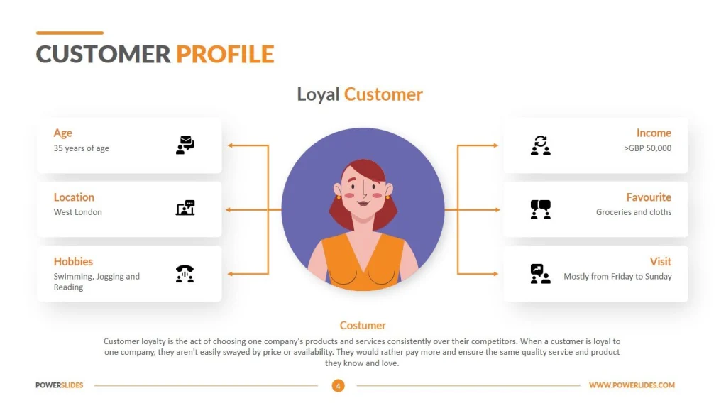
USER PROFILING

Slide 3

AGENDA
1. Data Collection:
Identify the sources of data: website analytics, app usage data, customer surveys, social media, etc.
Decide on the types of data to collect: demographic information, behavior patterns, preferences, etc
2.Data Processing and Integration:
Clean and preprocess the collected data to handle missing values, outliers, and inconsistencies.
Integrate data from multiple sources to create comprehensive user profiles.
Use data transformation techniques like normalization or feature scaling as needed.
3.Feature Selection and Engineering:
Identify relevant features for user profiling based on the defined objectives.
Conduct exploratory data analysis (EDA) to gain insights into the data and identify potential features.
Engineer new features if necessary to capture specific user behaviors or characteristics.
4.User Profile Creation:
Generate user profiles based on the output of the modeling and analysis phase.
Define attributes and characteristics for each user profile, such as demographics, interests, purchase history, etc.
Ensure that user profiles are actionable and useful for personalized marketing or product recommendations.
5.Validation and Iteration:
Validate user profiles by comparing them with ground truth data or conducting user surveys.
Iterate on the modeling and analysis process based on feedback and new data.
6.Implementation and Deployment:
Monitor the performance of user profiling systems and make adjustments as needed.

Slide 4

PROBLEM STATEMENT
Description:
Create user profiles from diverse data sources to deliver personalized recommendations for products, content, or services. Segment users based on demographics and behavior, model user preferences, and develop a recommendation engine integrated with user profiles.
Objectives:
Collect data from various sources.
Segment users based on demographics and behavior.
Model user preferences and interests.
Deliver personalized recommendations.
Validate and evaluate recommendation system.
Deliverables:
Detailed user profiling system.
Personalized recommendation engine.
Documentation and presentation of findings.
Benefits:
Enhanced user engagement and satisfaction.
Increased conversion rates and revenue.
Improved customer loyalty and retention.

Slide 5

PROJECT OVERVIEW
Objective:
The objective of this user profiling project is to analyze and understand user behavior, preferences, and characteristics in order to create detailed user profiles. These profiles will serve as a foundation for delivering personalized experiences, recommendations, and targeted marketing strategies. By segmenting users based on their demographics, behavior patterns, and interests, the project aims to enhance user engagement, satisfaction, and loyalty.
Expected Outcome:
The expected outcome of this user profiling project is the creation of comprehensive and actionable user profiles that provide valuable insights into user demographics, preferences, and behaviors. These profiles will enable businesses to tailor their products, services, and marketing efforts to better meet the needs and preferences of their target audience. Ultimately, the project aims to improve user engagement, conversion rates, and customer retention by delivering personalized experiences that resonate with individual users.

Slide 6

WHO ARE THE END USERS?
Marketing Teams
Product Managers
Sales Teams
Customer Support Teams
Business Analysts
Executives and Decision Makers
UX/UI Designers
Content Creators

Slide 7

YOUR SOLUTION AND ITS VALUE PROPOSITION
3/21/2024 Annual Review

Slide 8

THE WOW IN YOUR SOLUTION
3/21/2024 Annual Review
8

Slide 9
MODELLING
Teams cam add wireframes
3/21/2024 Annual Review
9

Slide 10
RESULTS
Demo Link
3/21/2024 Annual Review
10

